Slide 1
Machine Learning
Day 1 - Session 1

Slide 2
outlines
What is Machine Learning
Conventional Programing vs Machine Learning
Types of machine Learning
Building a Machine Learning Model

Slide 3
Artificial intelligence
Computer’s ability to mimic human (Natural) Intelligence
Artificial Intelligence
Machine Learning
Data Science

Slide 4
What is Machine Learning?

Slide 5
What is Machine Learning?

Slide 6
What is learning?
Learning (Noun) : The acquisition of knowledge or skills through study, experience, or being taught.

Slide 7



Slide 8
How do we solve this?
1 + 4 = 5
2 + 5 = 12
3 + 6 = 21
8 + 11 = ?

Slide 9
What is Machine Learning?
general definition:
“the field of study that gives computers the ability to learn without being explicitly programmed.” —Arthur Samuel, 1959
more engineering-oriented one:
“A computer program is said to learn from experience E with respect to some task T and some performance measure P, if its performance on T, as measured by P, improves with experience E.” —Tom Mitchell, 1997

Slide 10
THAT WAS HARD
Don’t worry, We’ll come back to that.

Slide 11
Let’s learn something new
Is a Horse acerous or non-acerous?
It’s natural if you don’t know what acerous means.
Let’s see if we can learn it by example

Slide 12





Non-acerous
?
acerous

Slide 13
Not good enough?
Let’s try with more data

Slide 14
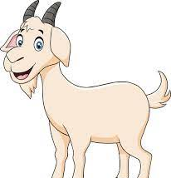
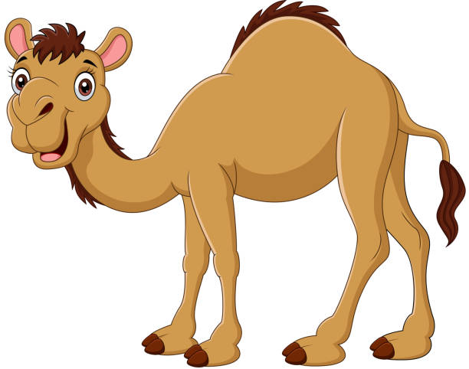

Non-acerous
?
acerous

Slide 15
Now What was Machine Learning?

Slide 16
What is Machine Learning?
“A computer program is said to learn from experience E with respect to some task T and some performance measure P, if its performance on T, as measured by P, improves with experience E.” —Tom Mitchell, 1997
the task T: is to flag spam for new emails,
the experience E: is the training data,
and the performance measure P: for example, you can use the ratio of correctly classified emails (accuracy).
If you just download a copy of Wikipedia, your computer has a lot more data, but it is not suddenly better at any task. Thus, it is not Machine Learning.

Slide 17
Why Machine Learning?

Slide 18
Why Machine Learning?
Short answer: Complexity and adaptivity.
Long answer: We can answer that with an example

Slide 19
Why Machine Learning?
Emails filtering (Spam/Ham filtering):
As the name suggests It’s filtering you emails for spam emails.
Spam emails: also referred to as junk email or simply spam, is unsolicited messages sent in bulk by email (spamming)

Slide 20
Conventional Programming
using traditional programming techniques:
First you would look at what spam typically looks like. You might notice that some words or phrases (such as “4U,” “credit card,” “free,” and “amazing”) tend to come up a lot in the subject. a few other patterns in the sender’s name, the email’s body, and so on. (This sounds tedious since you will be looking at hundreds if not thousands of emails.)
You will come up with patterns and write an algorithm for detecting these patterns.(Your program will be hundreds of lines to account for hundreds of patterns.)
You will test your program and repeat steps 1 and 2 until its good enough.

Slide 21
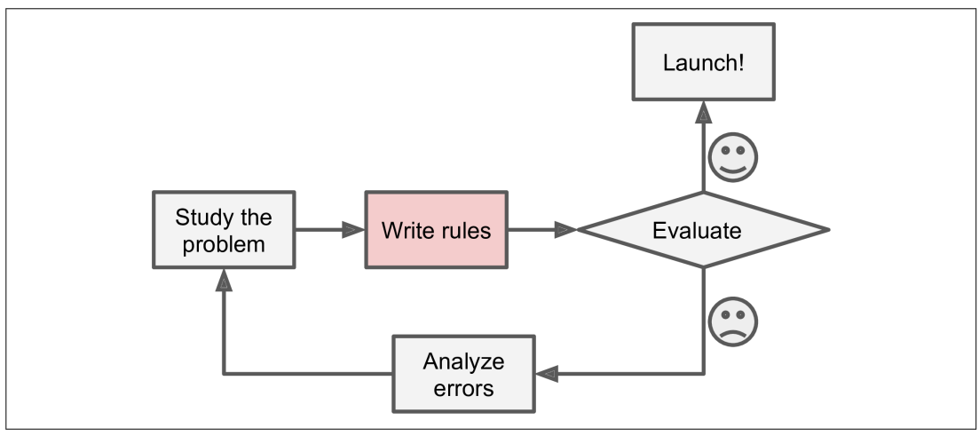
Conventional Programming

Slide 22
But is that good enough?

Slide 23
Conventional Programming
what if spammers knew about these patterns and changed their ways?
For example:
if spammers notice that all their emails containing “4U” are blocked, they might start writing “For U” instead.
using traditional programming techniques would need to be updated to flag “For U” emails. If spammers keep working around your spam filter, you will need to keep writing new rules forever.

Slide 24
Good
G00d
Go0od
Goooooooooooooood
Very good
It is not good

Slide 25
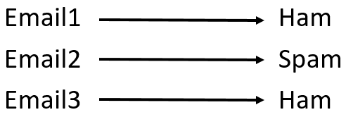
Machine Learning
In contrast, a spam filter based on Machine Learning techniques:
learns which words and phrases are good predictors of spam by detecting unusually frequent patterns of words in the spam examples compared to the ham examples.
The program is much shorter, easier to maintain, and most likely more accurate.

Slide 26
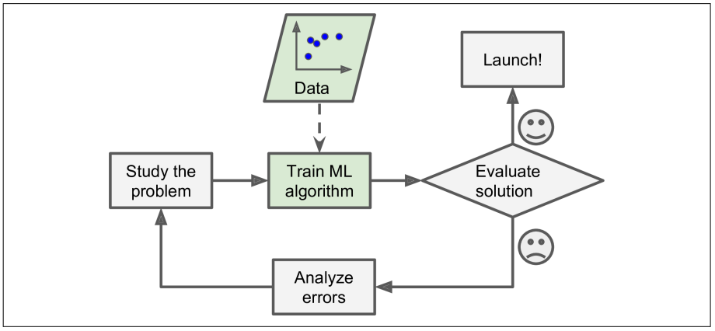
Machine Learning

Slide 27
Machine Learning
Not only that
One of the best strengths of machine learning is adabtivity to data changing.
a spam filter based on Machine Learning techniques automatically notices that “For U” has become unusually frequent in spam flagged by users, and it starts flagging them without your intervention

Slide 28
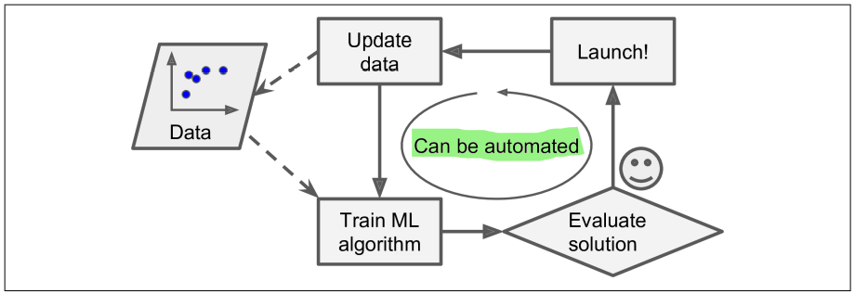
Machine Learning

Slide 29
Conventional Programming Vs Machine Learning
So in short:
In Conventional programing, I will detect the pattern and write the code that will find these patterns in an email.
In Machine Learning, I only need to provide a good set of labeled data and leave the pattern detection and finding to the machine learning algorithm.
So machine learning solves both complexity and adaptivity problems.

Slide 30
ML
Data + result ➔rule
Traditional
Data + rule ➔ result

Slide 31
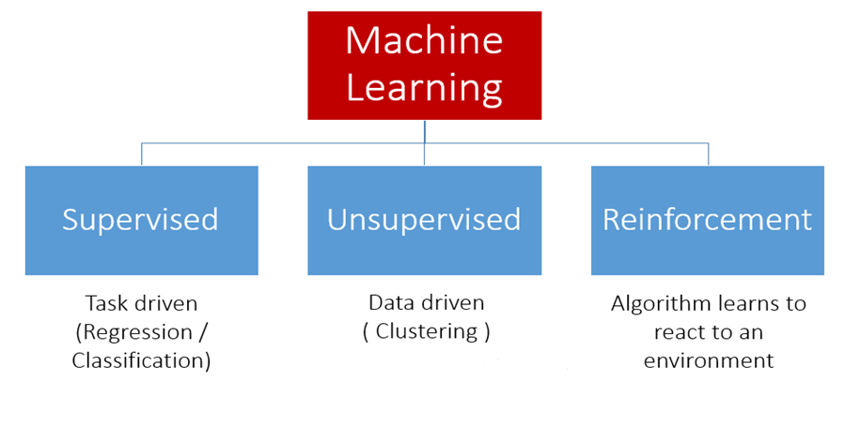
Types of machine learning

Slide 32
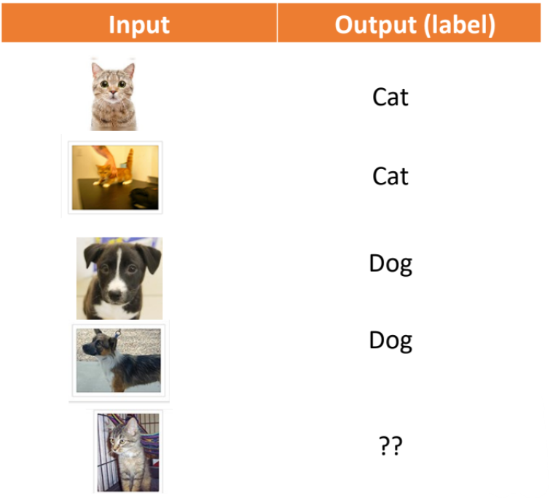
Supervised Learning
Much like the Emails example.
Works on Labeled data where
you know the correct output.
Our Focus on this course

Slide 33
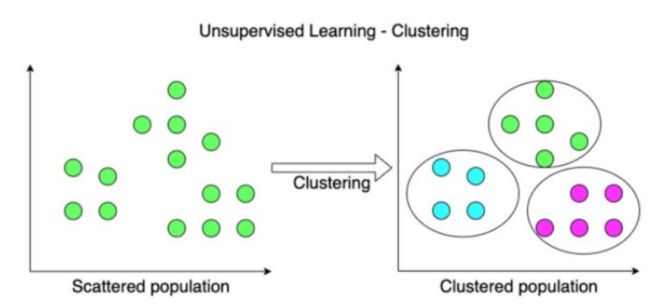
Unsupervised Learning
Explore the dataset
• No labels/ desired outcome
• Discover regularities and hidden
structures in data.
• Correct output is not known.
• Example applications
• Clustering: organize instances into
subgroups or clusters without any
upfront knowledge.
• Dimensionality reduction: extract
the most relevant
information/features.

Slide 34
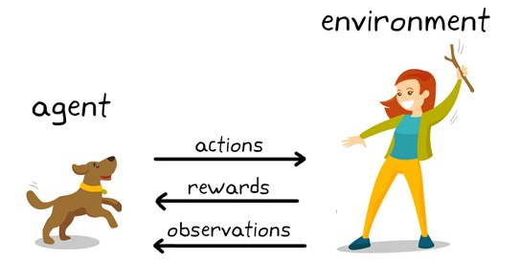
Reinforcement Learning
• Learn by practice
• An intermediate setting between
supervised and unsupervised learning
• The goal is to learn through actions. A
reward signal indicates if the action is
good or bad.
• By interacting with the environment,
the agent learns how to maximize the
reward function.

Slide 35
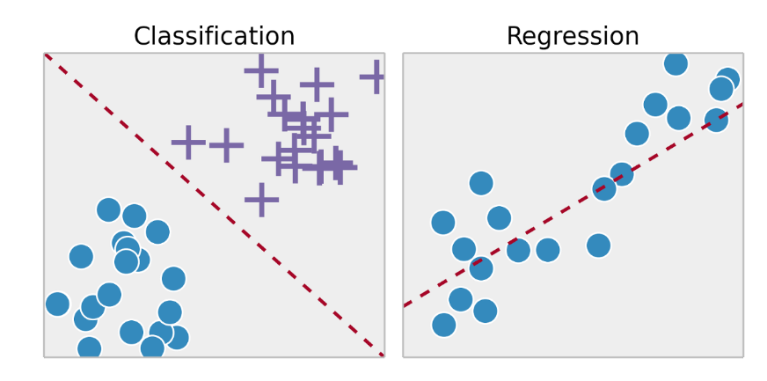
Supervised Learning

Slide 36
Classification
Where the output is discrete and have fixed number of possibilities.
Classify species of flowers
Classify emails spam/ham
We can have 2 classes or more.
Our goal is to draw a decision boundary to classify new example.

Slide 37
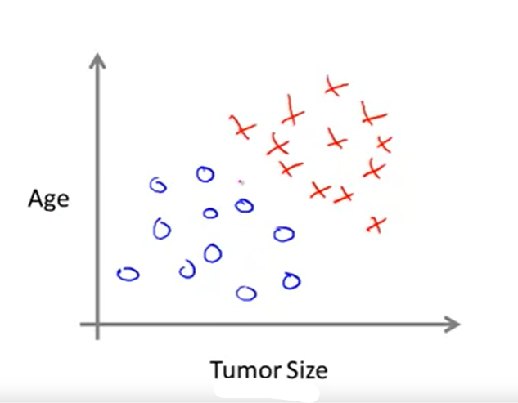
Classification
Every axis(dimension) is a feature
in case of 2 or 3 features we can visualize the decision boundary.
But after 3 features it becomes hard to visualize so we have to trust in math.

Slide 38
Regression
Where the output is continuous.
Predict the price of a house
Our goal is to fit a curve/line through the data points.
The distance between each point and the line is minimized to achieve the best fit curve/line.

Slide 39
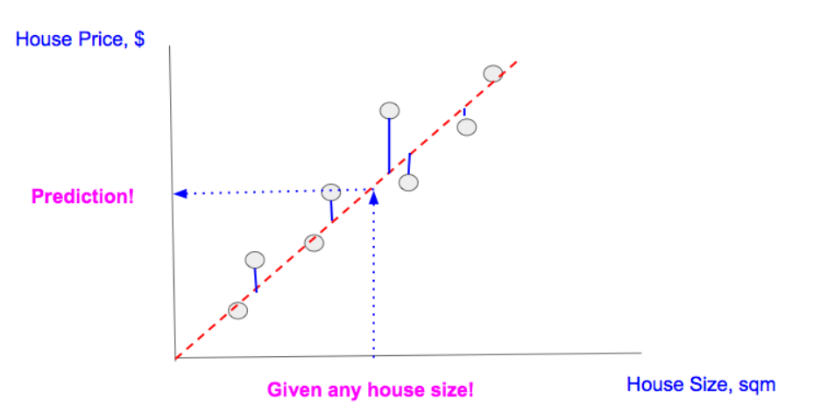
Regression
In this example we have only 1 feature (House Size) and we use it to predict the output (House Price).
We can visualize up to 2 features but more than that we again have to trust in math.

Slide 40
What Do we need to build a machine learning model?

Slide 41
Building a Machine Learning model
To Build a Machine Learning Model we Need:
1- Task not hard
2- Experience (Data) not always easy
3- Performance measure not hard

Slide 42
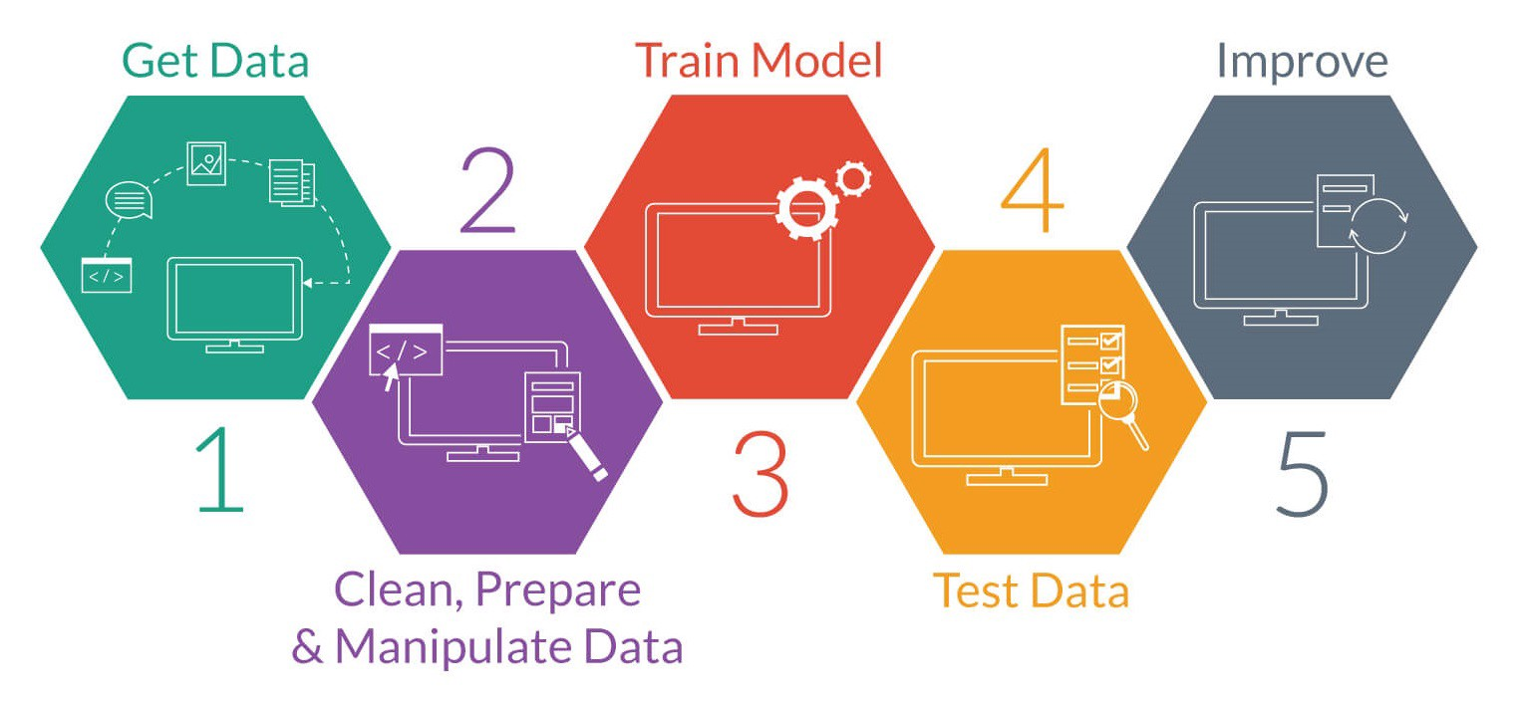
Building a Machine Learning model

Slide 43
Data Collection
For an innovative project:
you need to be innovative ☺ --
Collect data yourself, simulations, use existing data in a different way, .. find a way
In many cases, you may deal with legacy systems and extract data from them

Slide 44
Data
Data needs to be in the form of:
Features
Numerical (Quantitative)
Categorical (Qualitative)
Ordinal : categories has relative order like grades (A , B+ , C, etc)
Nominal : categories has no relative order like gender (Male, Female)
Labels
Continues : in regression
Discrete : in classification

Slide 45
Now I have the data, can I build the model?
Not yet, you have to prepare the data

Slide 46
Data Preparation
Combine data from various sources
Check data schema:
Usually the source of the data has schema describing the data
Clean your Data: identify and handle errors in your data.
Handle Missing data
Handle outliers
Data Transformation: change the scale of some/all variables. Why?? We will discuss it later.
Feature Selection: select these features that are most relevant to your task.
Feature Engineering: combine features, derive new variables, dimensionality reduction, etc.

Slide 47
Exploratory Data Analysis
We can’t prepare the data without first exploring the data.
Quantify missing data
Identify numerical and categorical variables
Determine unique values (cardinality) in categorical features
Check rare/ dominant categories in categorical features
Highlight outliers
Identify linear relationships
Identify a normal distribution
Check histograms

